Slide 1

Opportunities at the California Water-Energy Nexus
Frank Loge
Professor
Department of Civil and Environmental Engineering
University of California Davis

Slide 2
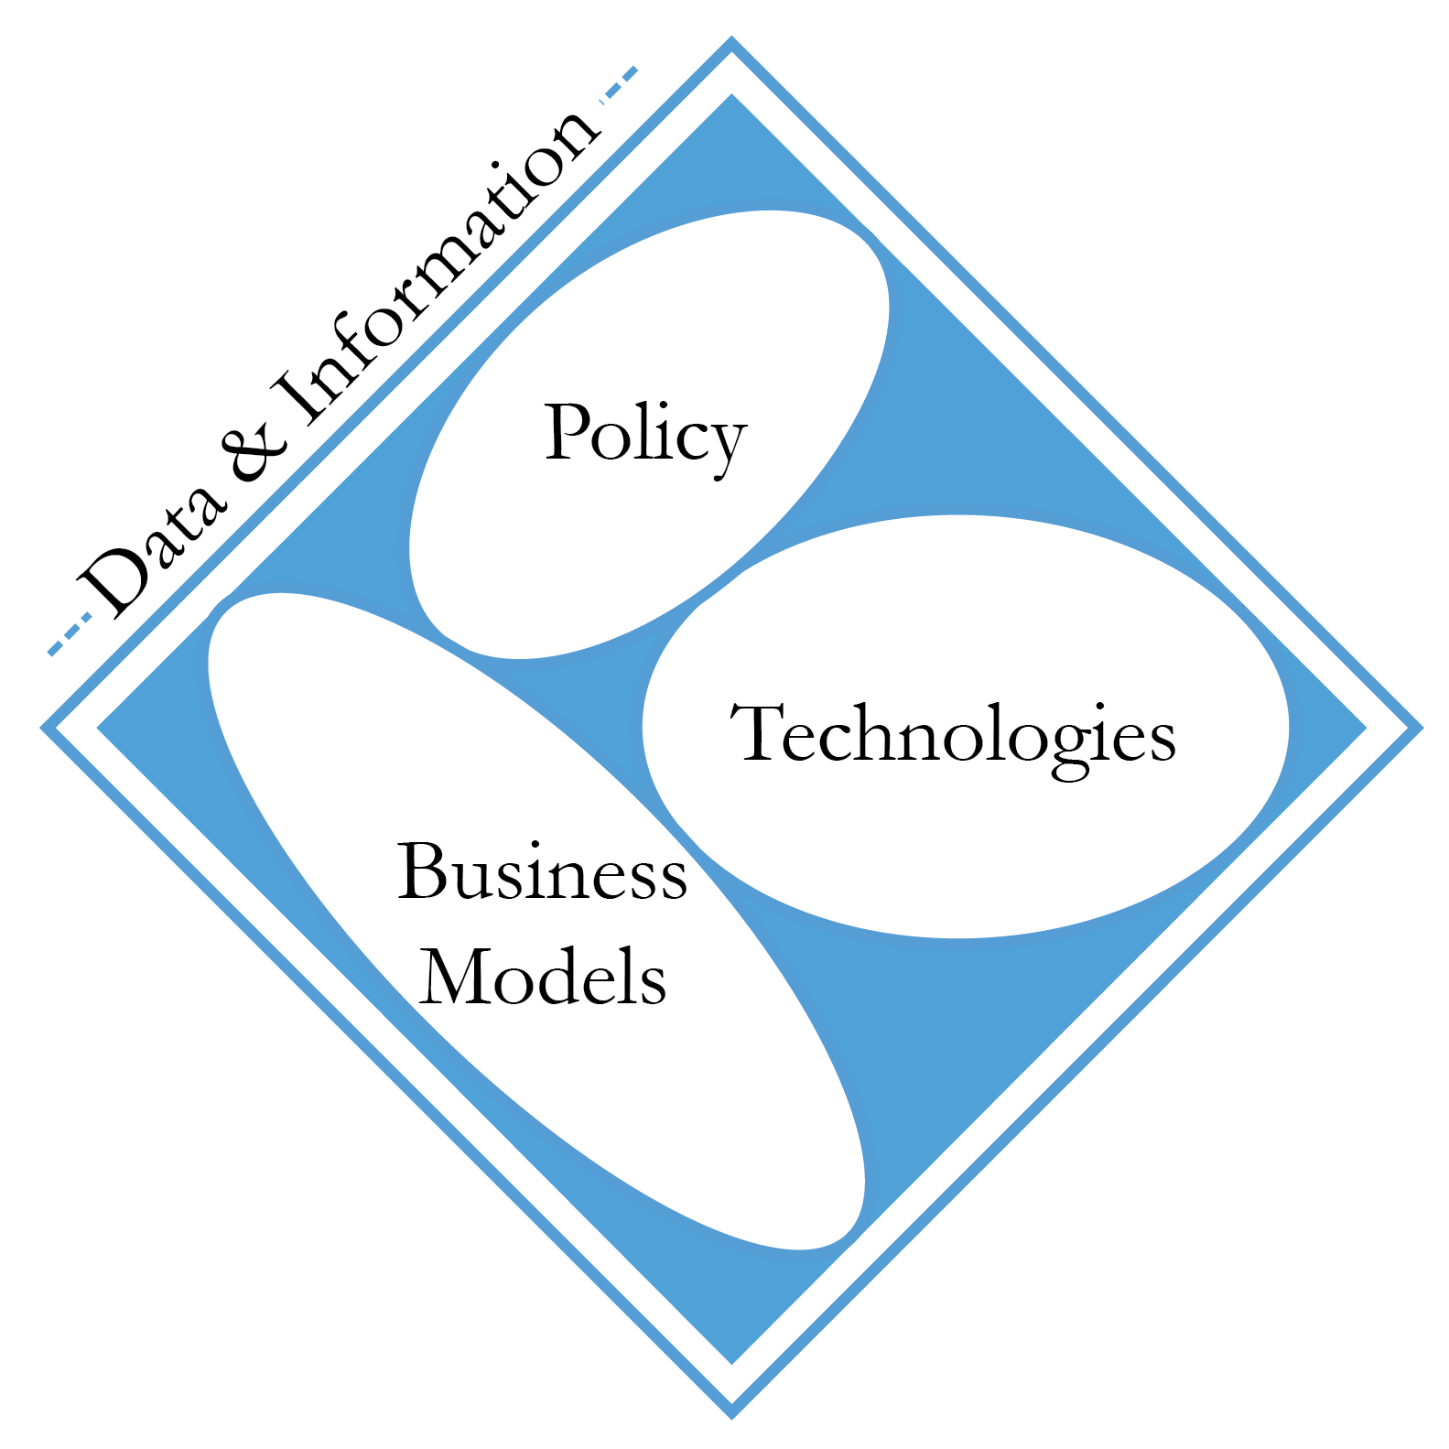
The Information Bottleneck
California leading state in water-energy activity
AB 32
CPUC Guidance
WET-CAT
But limited by availability of actionable data

Slide 3
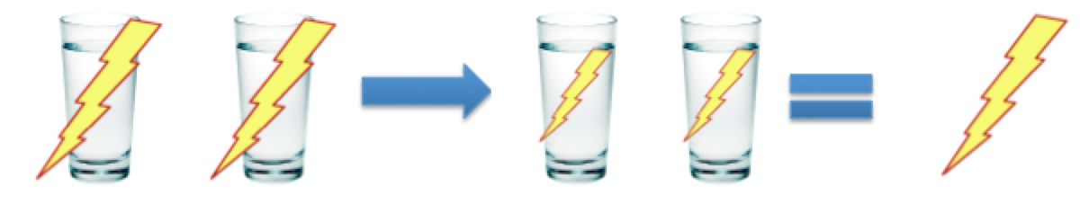
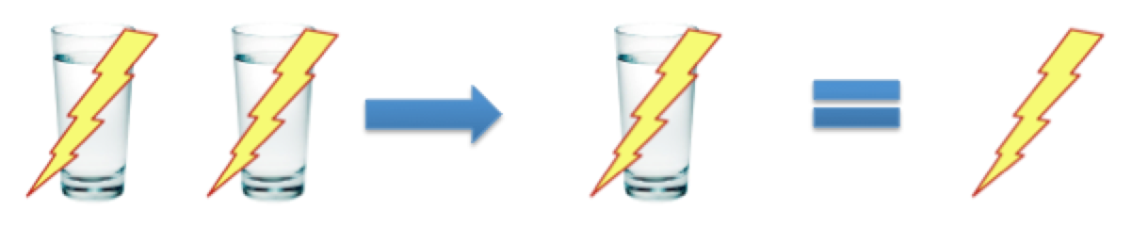
Saving Energy with Water
Energy Efficiency of Water System
Energy Savings through Water Efficiency

Slide 4
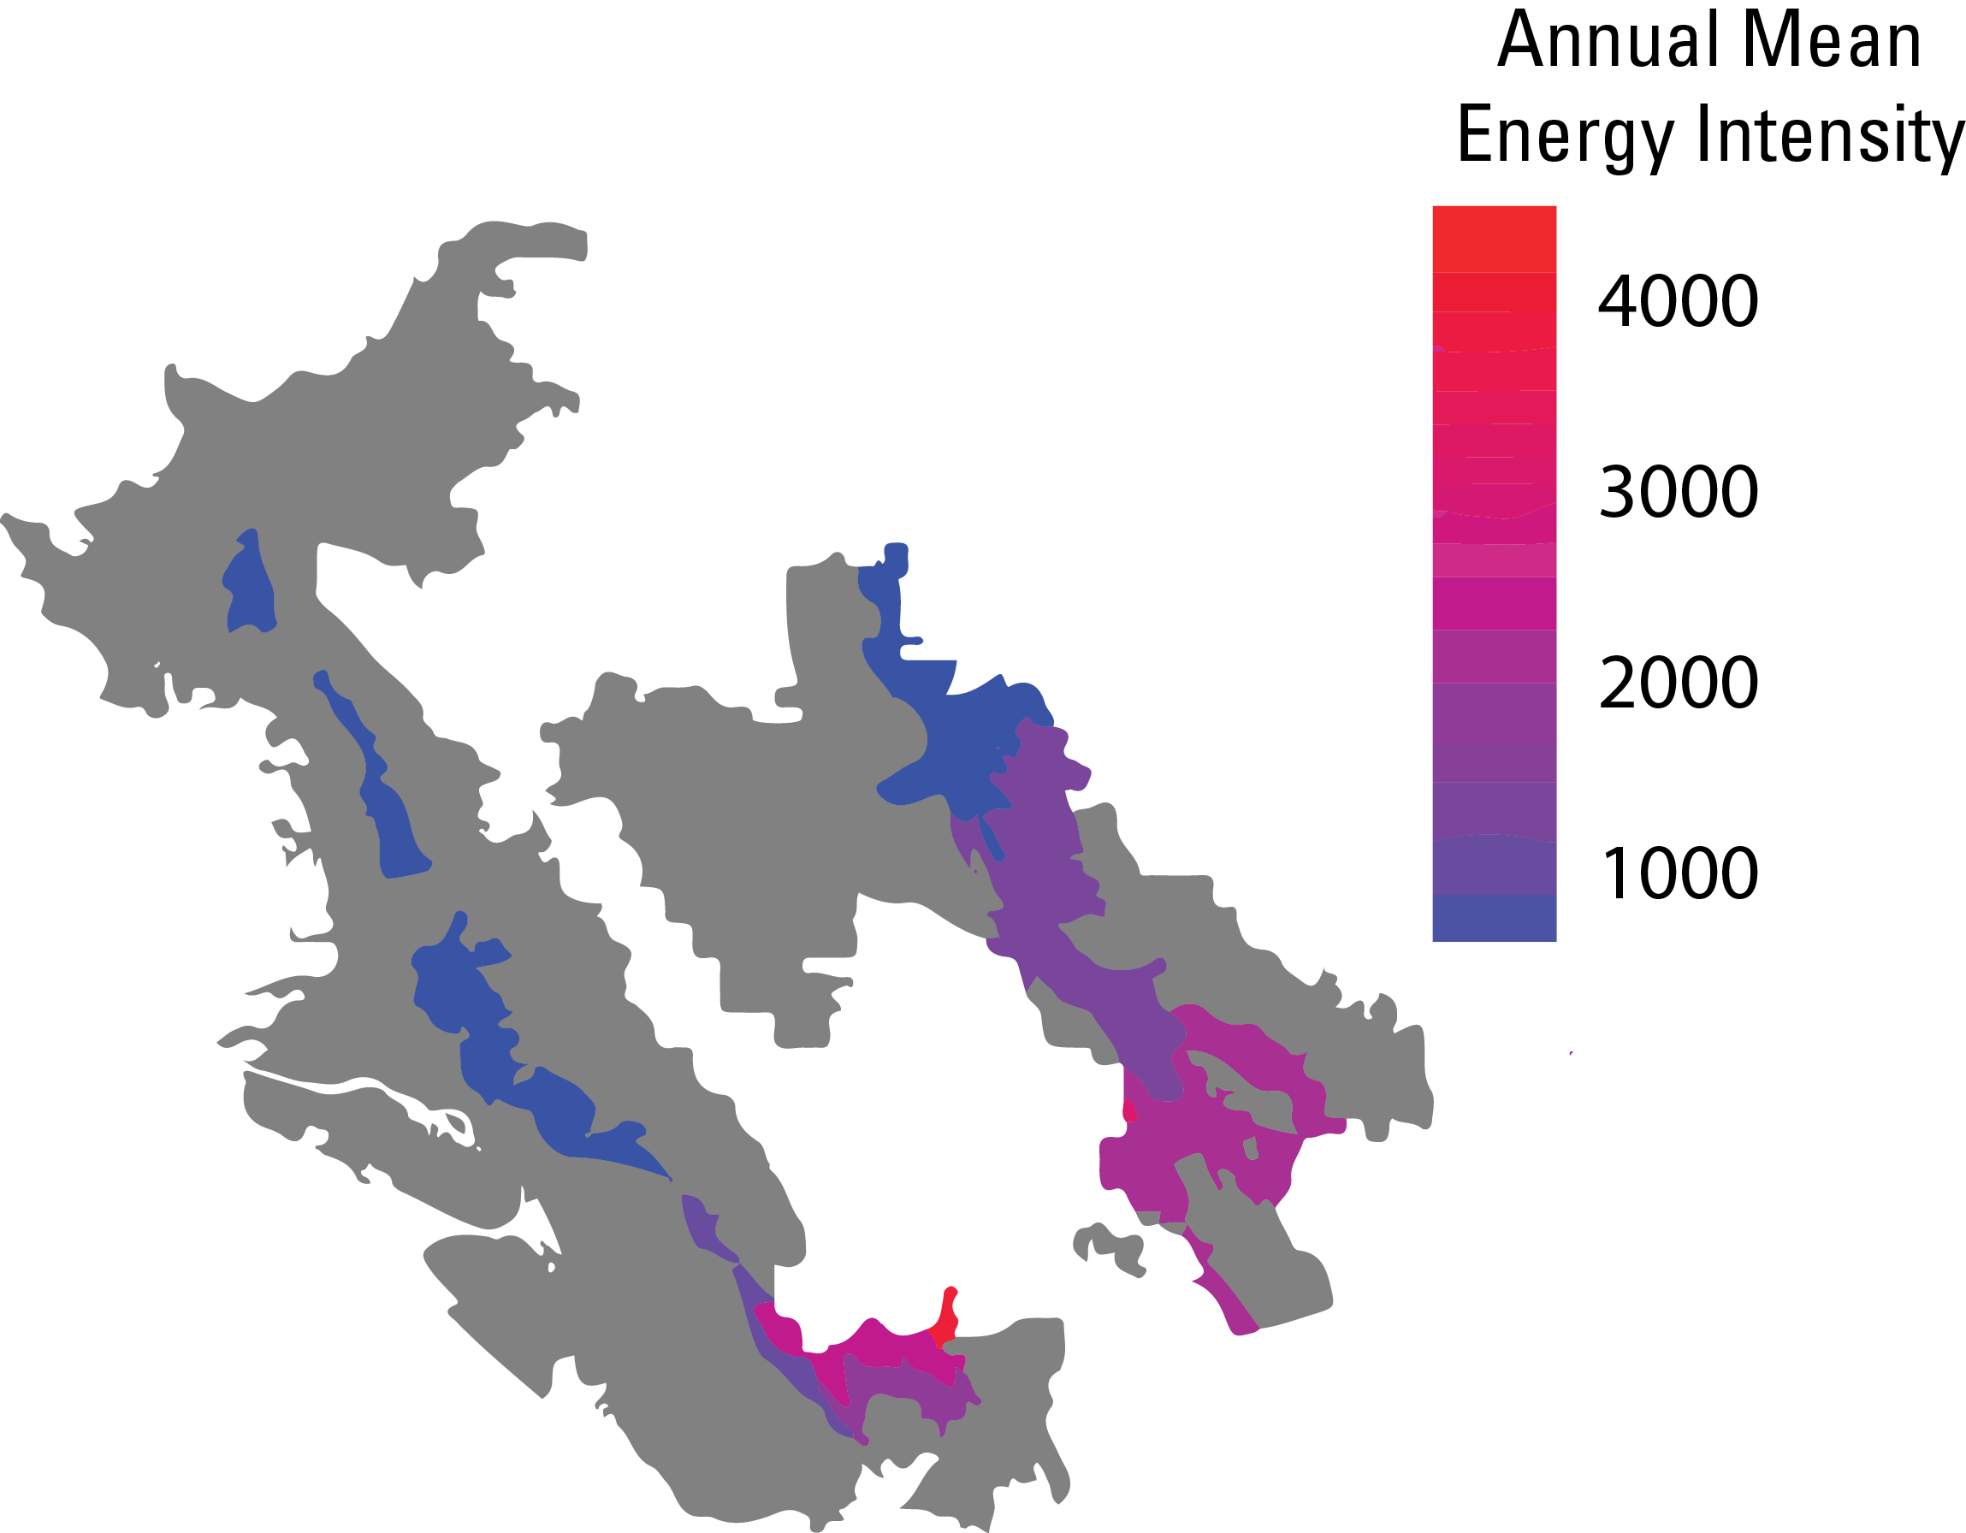

Case Study: East Bay MUD
Results:
10-12% monthly variation around the annual mean
>12X difference across the distribution network

Slide 5
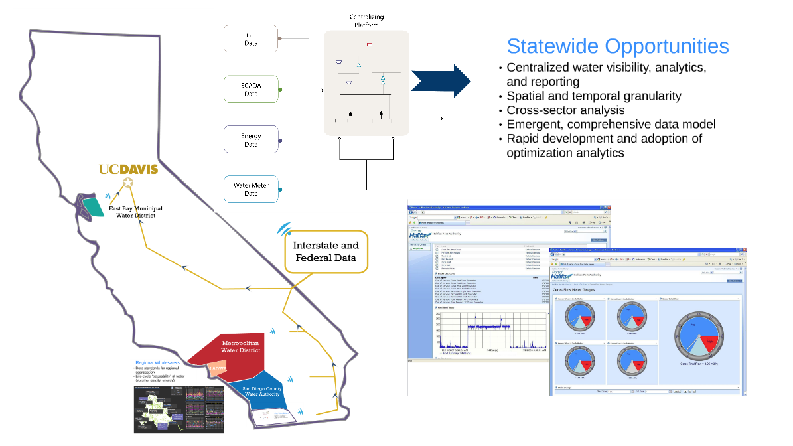
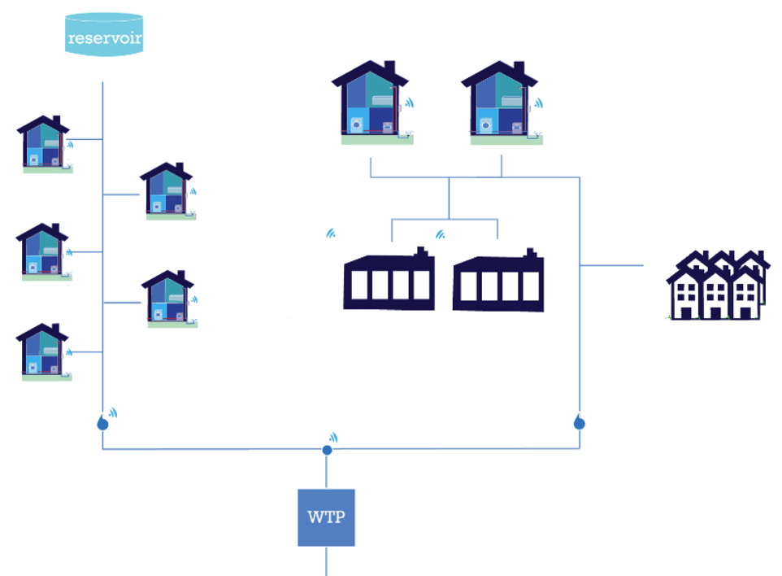
The Complexity
Multiple scales
Multiple and overlapping jurisdictions

Slide 6
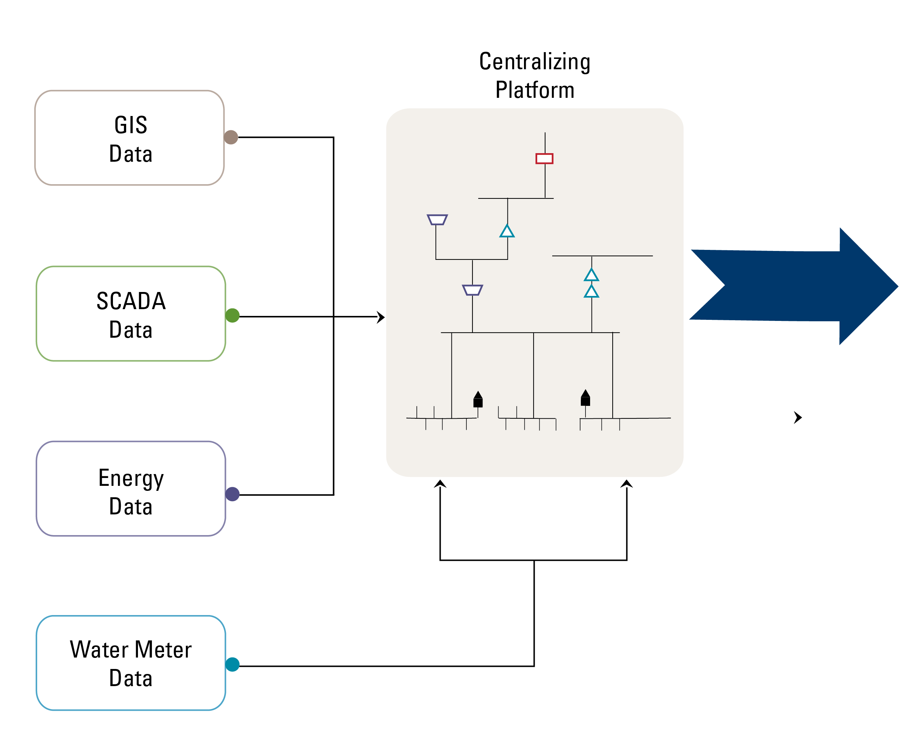
Opportunities
ANALYTICS
Water Benefits
Water Use Benchmarking
Targeted Conservation
Leak Loss Detection
Monitoring and Verification
Energy Benefits
Energy Intensity
Demand Response
Peak Shaving/Shifting
Energy Storage
Monitoring and Verification

Slide 7
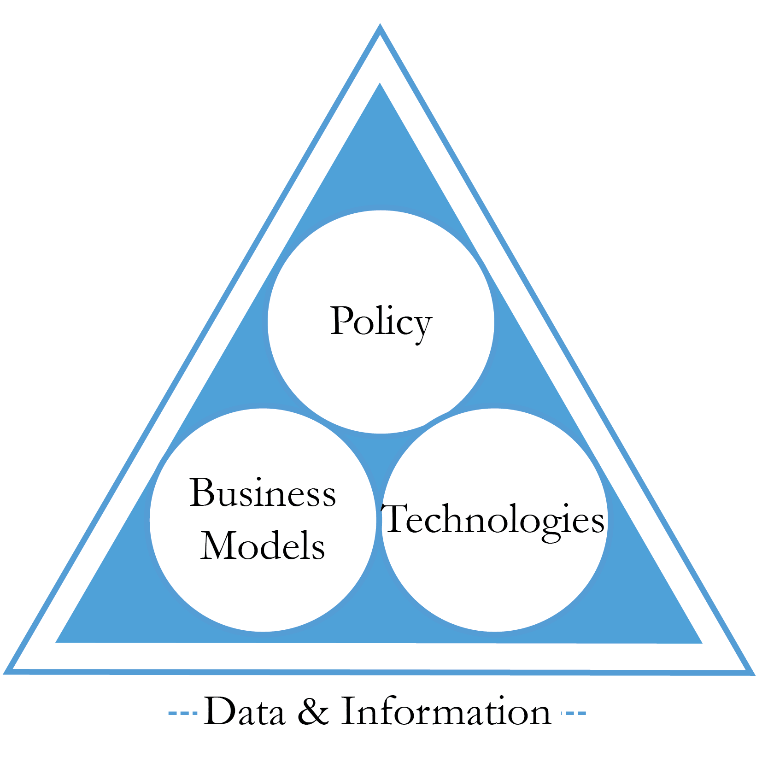
Next Steps
Aligning Water and Energy Data
Common data platform
Security and privacy provisions
Suite of analytics
Funding (e.g., PGC)
Stakeholder engagement
Drive Innovation in Policy, Technology, and Business Models

